Slide 1


Slide 2
Let’s have glimpse of the problems…
We normally face as a student of Finance and we need to answer them in SCIENTIFIC MANNER!!!!!!!!!!!!!

Slide 3

What is Futures and options????

Slide 4

How do we know that a option price is undervalued or over valued!!!!!

Slide 5

Which model of option pricing is better binominal or BSM

Slide 6
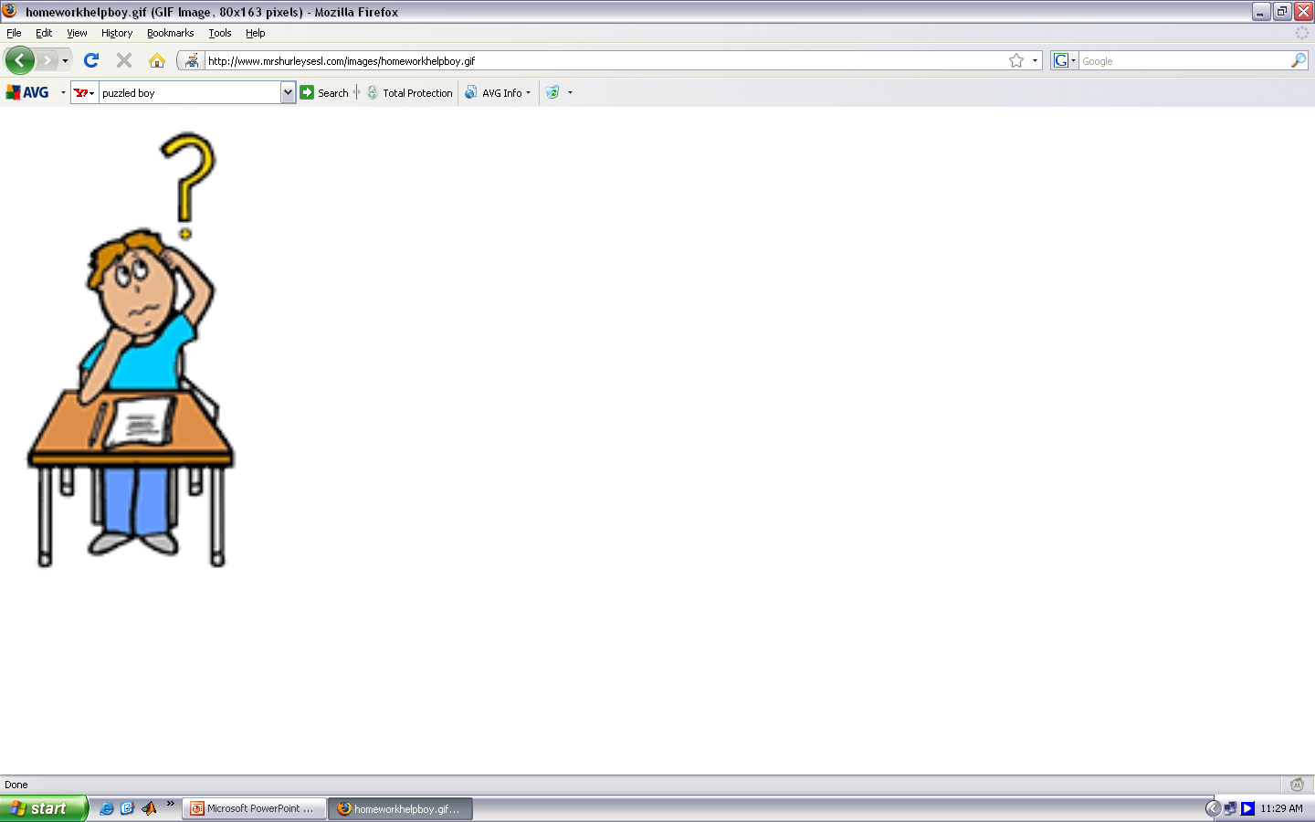
Who are arbitrageurs

Slide 7
Who are speculators

Slide 8


Who are hedgers

Slide 9

Is it possible for me to know at what time I should buy or sell

Slide 10
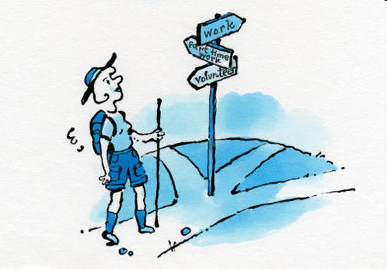
If you are looking forward to answer the issues raised, then you have to enter into the world of……

Slide 11

Derivatives

Slide 12

This Class will take you to the WORLD of Stock market first!!!!

Slide 13
Look!!! I am having lot of money with me and want to invest. I really do not know - should I look for investment in bonds or equity? Can you help me?
He is a high net worth person and looking for some who can manage his wealth.

Slide 14
If you are given a sum of Rs. 10 lakhs, then how you will decide where to put the money? - in Bonds? In Shares? In both? How much in each?

Slide 15

IS 2022 a YEAR of Bonds or Equity?

Slide 16
During the phase of rapid growth in an economy, should you invest in bonds or shares?
How to safeguard oneself against Business Cycles?

Slide 17
This man is having RBI Bonds. Is he exposed to any kind of risk?
RBI Bonds
8%, 2018

Slide 18
This man has read in a newspaper that the Indian Economy is expected to grow at 3.50% for 2022-23 and the inflation rate ending last week is more than 1% of the previous week. The Fed is thinking to increase its bank rate in near future. He has huge exposure in long-term Government Bonds.
I think he has become crazy!! One should feel happy about higher growth rate and increasing inflation rate as it shows increasing optimism in the economy which is badly required by all of us.
Feeling very upset due to the news.

Slide 19

Should you hold individual securities or hold them as a portfolio?

Slide 20

These issues are bothering me and I believe that they may be bothering you too!!!!,
If not today then may be in near future.

Slide 21
As a man of finance, we have to address and understand all such issues. And, the todays class will definitely help us in this regard.

Slide 22

WELCOME TO THE
Stock Markets

Slide 23
Objective of Today’s session - Putting the things in RIGHT PLACES

Slide 24
Structure
Real Assets
Financial Assets
Money Market
Equity and Derivatives
FX Market
Bond Market
Primary Market
Secondary Market

Slide 25
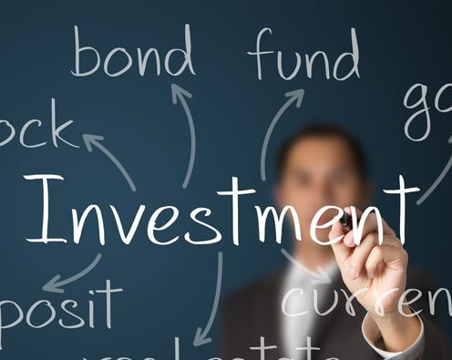
What is investment?
Issue#1

Slide 26
Investment
“A sacrifice of current money or other resources for future benefits”.

Slide 27
Why should we investment?
Issue#2

Slide 28
OBJECTIVES OF INVESTMENT
To generate maximum RETURN/INCOME/ PROFIT/ BENEFITS.
To minimise the risk involved.
To ensure sufficient liquidity(?).
To get tax-benefits.
To safeguard against rising prices (hedging).

Slide 29
Where should we investment?
Issue#3

Slide 30
Real Assets Vs. Financial Assets

Slide 31
We should investment in a financial assets …
We shall restrict ourselves to TWO KINDS of financial assets –
FIXED INCOME SECURITY – BOND
VARIABLE INCOME SECURITY - EQUITY

Slide 32
Where should one investment?
Issue#4

Slide 33
One should invest in Financial Markets!
Primary Market –
IPOs and FPOs
Secondary Market –
Stock Exchanges

Slide 34
IPO and FPO

Slide 35
Secondary Market – Stock Exchanges

Slide 36
First - Few basic of stock market

Slide 37
Spot or equity
The spot market or cash market is a financial market in which securities are traded for immediate delivery.
In a spot market, settlement normally happens in T+1 working days, i.e., delivery of cash and commodity must be done after two working days of the trade date.

Slide 38
Your Bank A/C
Seller Bank A/C
Buyer
Stock Market
Seller
Your Demat A/C
Seller Demat A/C

Slide 39
Before
After
Bank A/C = 200000
Demat A/C = NIL
Bank A/C = 100000*
Demat A/C = 400 SBI#
Assuming Share worth rupees 100000
# SBI @ 250 at the time of trade

Slide 40
DERIVATIVES

Slide 41


Problem of a student…
What is DERIVATIVES sir!!!!

Slide 42
DERIVATIVES
In the Indian context the Securities Contracts (Regulation) Act, 1956 (SC(R)A) defines "derivative" to include-
A security derived from a debt instrument, share, loan whether secured or unsecured, risk instrument or contract for differences or any other form of security.
A contract which derives its value from the prices, or index of prices, of underlying securities.
Derivatives are securities under the SC(R)A and hence the trading of derivatives is governed by the regulatory framework under the SC(R)A.

Slide 43

DERIVATIVE PRODUCTS
Forwards:
A forward contract is a customized contract between two entities, where settlement takes place on a specific date in the future at today's pre agreed price.

Slide 44
DERIVATIVE PRODUCTS
Meet Mr. X. Currently he exports 100 tones of wheat to the USA and he will receive 100000$ in the month of Aug.

Slide 45

Current USDINR rate is 80 per $

Slide 46

But Que. is what will be the rate of USDINR in the month of Aug??????????

Slide 47
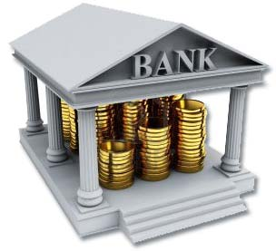

Now Mr. X. will go to bank and enter into a contract which is called a forwards contract.

Slide 48
Contract details
Forwards:
A contract between Mr. X and Bank, where settlement takes place on Aug at today's pre agreed price that may be 82 per $, Quantity is 1 Lakh $, place of delivery will be Mumbai.

Slide 49
Contract details
Forwards: can be for commodity, stock, interest rate, etc.
Such as
A contract between Mr. X and Mr. Y, where settlement takes place on a Aug at today’s pre agreed price 28500 per 10 gram of gold, Quantity is 1 kg, the currency will be Rupee, place of delivery will be Say, Mumbai. etc.

Slide 50
Example
Where,
Time of Delivery -----You decide
Place of delivery -----You decide
Quantity -----You decide
Quality -----You decide
Currency -----You decide

Slide 51


Slide 52

DERIVATIVE PRODUCTS
Futures:
A futures contract is a standardized contract between two parties to buy or sell an asset at a certain time in the future at a certain price.

Slide 53
Example
Stock exchange,
Where,
Time of Delivery is Fixed
Place of delivery is Fixed,
Quantity per lot is Fixed,
Quality is Fixed,
Currency is Fixed,
Price is driven by Demand and Supply.

Slide 54


Slide 55

DERIVATIVE PRODUCTS (continued…)
Options: Option means choice.
In stock market option also means choice between buy or not to buy (sell or not to sell)
Option - Option give the right to buy/sell but not the obligation to buy/sell a given quantity of the underlying asset, at a given price on or before a given future date.

Slide 56
DERIVATIVE PRODUCTS (continued…)
Options: Options are of two types –
Call Option - Calls option give the buyer the right to buy but not the obligation to buy a given quantity of the underlying asset, at a given price on or before a given future date.
Put option - Puts option give the buyer the right to sell, but not the obligation to sell a given quantity of the underlying asset at a given price on or before a given date.

Slide 57
Features of derivative markets
Derivative are of three kinds
Future or forward contract
Options
Swaps.

Slide 58
Features of derivative markets
Low counterparty risk,
Transactions costs are low.
Contract has to be settled by delivery or cash.
By taking just opposite position party can reverse the contract.
When value of underlying assets change then value of derivatives also changes.

Slide 59
FORWARD CONTRACTS
The salient features of forward contracts are:
Each contract is customized.
Contract has to be settled by delivery.
Contract price is not available in public domain.
If the party wishes to reverse the contract, it has to compulsorily go to the same counter-party.
Counter-party risk.

Slide 60
LIMITATIONS OF FORWARD MARKETS
Forward markets world-wide are afflicted by several problems:
Lack of centralization of trading.
Illiquidity.
Counterparty risk.

Slide 61
Why Forwards?
They are customized contracts unlike Futures and they are:
Tailor-made and more suited for certain purposes.
Useful when futures do not exist for commodities and financials being considered.
Useful in cases futures’ standard may be different from the actual.

Slide 62
Types of Futures Contracts
Physical commodities
Agricultural (e.g., corn, livestock)
Non-agricultural (e.g., lumber, oil, gold)
Financial futures
Currency futures
Stock index / Stock futures
Interest rate futures

Slide 63
Futures & Forwards Distinguished
FUTURES | FORWARDS
They trade on exchanges | Trade in OTC markets
Are standardized | Are customized
Identity of counterparties is irrelevant | Identity is relevant
Regulated | Not regulated
Marked to market | No marking to market
Easy to terminate | Difficult to terminate
Less costly | More costly

Slide 64
FUTURES TERMINOLOGY
Spot price: The price at which an asset trades in the spot market.(delivery in t+2 basis)
Futures price: The price at which the futures contract trades in the futures market. (delivery in t+n basis)
Contract cycle: The period over which a contract trades. The index futures contracts have 1 month, 2 months and 3 months expiry.

Slide 65
FUTURES TERMINOLOGY
Expiry date: This is the last day on which the future contract will be traded, at the end of which it will cease to exist.
Contract size: The amount of asset that has to be delivered under one contract. Also called as lot size.

Slide 66
Margins

Slide 67
Margins
A margin is cash or marketable securities deposited by an investor with his or her broker.
Buyer or seller both have to deposit a token payment to broker and broker will deposit this money to exchange. This token money is called margin.

Slide 68

Why should there be margins?

Slide 69
Margins
Suppose a Buyer,
On January 1, 2019 - Purchases 1000 shares of ‘xyz’ company at Rs.100/-.
Then buyer has to give the purchase amount of Rs.1,00,000/- (1000 x 100) to his broker on or before next day.
Broker, in turn, has to give this money to stock exchange.

Slide 70
Margins
There is always chance that the buyer may not be able to bring the required money by required date.
Hence, buyer is required to pay a portion of Rs.1,00,000/- to the broker at the time of placing the buy order.
This initial token payment is called margin.

Slide 71


Slide 72
Remember, for every buyer there is a seller
If the buyer does not bring the money, seller may not get his / her money and vice versa.
Therefore, margin is levied on the seller also.
To ensure that seller gives the 100 shares.

Slide 73
Margin payments ensure that each investor is serious about buying or selling shares.

Slide 74

Sir!!!
Are margins same across cash and derivatives markets?

Slide 75
No!!!!!!!!!!
Shares traded on cash market are settled in two days
Whereas derivative contracts may have longer time to expiry.
Therefore, types of margins levied in the cash market segment and derivative are different

Slide 76
Cash Market

Slide 77
Cash Market Margins
Margins in the cash market segment comprise of the following three types:
Initial Margin
Value at Risk (VaR) margin
Extreme loss margin
Mark to market Margin

Slide 78
Value at Risk (VaR) margin
VaR is a technique used to estimate the probability of loss of value of a security, based on the statistical analysis.
A VaR statistic has three components:
Time period,
Confidence level
Loss amount (or loss percentage)

Slide 79
Value at Risk (VaR) margin
For example,
VaR_{1,99} = 1000
There is only 1% chance, loss this security will exceed 1000 in 1 Day.
VaR_{10,95} = 10000
There is only 5% chance, loss this security will exceed 10000 in 10 Day.

Slide 80
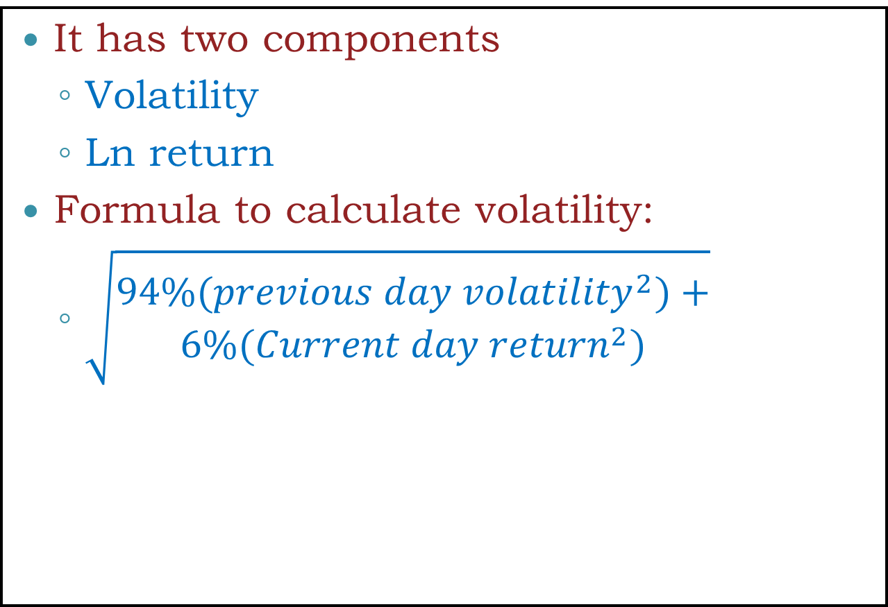
Calculation of VaR margin.
It has two components
Volatility
Ln return
Formula to calculate volatility:
$\sqrt{\begin{aligned}94\%({previous day volatility}^{2})+ \\ 6\%({Current day return}^{2})\end{aligned}}$

Slide 81
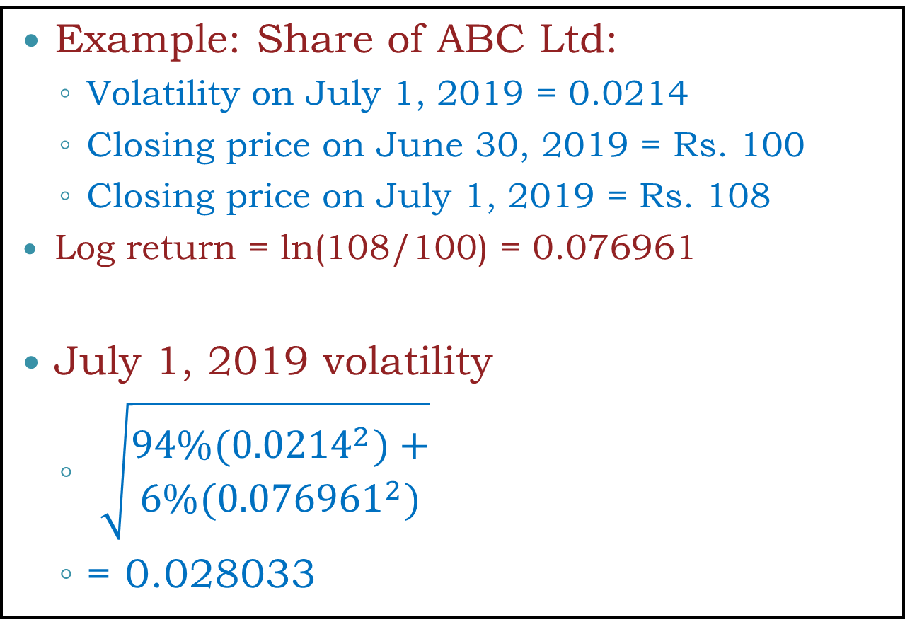
Calculation of VaR margin.
Example: Share of ABC Ltd:
Volatility on July 1, 2019 = 0.0214
Closing price on June 30, 2019 = Rs. 100
Closing price on July 1, 2019 = Rs. 108
Log return = ln(108/100) = 0.076961
July 1, 2019 volatility
$\sqrt{\begin{aligned}94\%({0.0214}^{2})+ \\ 6\%({0.076961}^{2})\end{aligned}}$
= 0.028033
This is Volatility not VaR Margin

Slide 82

Sir!!!
How to calculate Volatility?

Slide 83
Date | Price | Formulas | Value
Jul 26, 2019 | 1213.8 | =LN(B2/B3) | -0.0144770041588379
Jul 25, 2019 | 1231.5 | =LN(B3/B4) | -0.0221642414470621
Jul 24, 2019 | 1259.1 | =LN(B4/B5) | -0.0114110965178472
Jul 23, 2019 | 1273.55 | =LN(B5/B6) | -0.00544235011407788
Jul 22, 2019 | 1280.5 | =LN(B6/B7) | 0.0249073955140023
Jul 19, 2019 | 1249 | =LN(B7/B8) | -0.0102356669572542
Jul 18, 2019 | 1261.85 | =LN(B8/B9) | -0.0157254488720146
Jul 17, 2019 | 1281.85 | =LN(B9/B10) | -0.00866075281701096
Jul 16, 2019 | 1293 | =LN(B10/B11) | 0.013156548031927
Jul 15, 2019 | 1276.1 | =LN(B11/B12) | -0.0034420748996494
Jul 12, 2019 | 1280.5 | =LN(B12/B13) | -0.000819656180625368
Jul 11, 2019 | 1281.55 | =LN(B13/B14) | 0.00210904624341277
Jul 10, 2019 | 1278.85 | =LN(B14/B15) | -0.000976963285271456
Jul 09, 2019 | 1280.1 | =LN(B15/B16) | 0.0221559918972086
Jul 08, 2019 | 1252.05 | =LN(B16/B17) | -0.00898471496862236
Jul 05, 2019 | 1263.35 | =LN(B17/B18) | -0.0162132823164288
Jul 04, 2019 | 1284 | =LN(B18/B19) | 0.0011299216101542
Jul 03, 2019 | 1282.55 | =LN(B19/B20) | 0.00316276790851098
Jul 02, 2019 | 1278.5 | =LN(B20/B21) | 0.00757653731310811
Jul 01, 2019 | 1268.85 | =LN(B21/B22) | 0.0124904972468938
Jun 28, 2019 | 1253.1 | =STDEV.P(C2:C21) | 0.0124650402372948

Slide 84
Value at Risk (VaR) margin
To Calculate at VaR margin rate, companies are divided into 3 categories based on
Shares trade
Liquidity
How much a large buy or sell order changes the price of the scrip, what is technically called ‘impact cost’.

Slide 85
Value at Risk (VaR) margin
These 3 categories are:
Group 1
Regularly traded (more than 80% of the trading days in the previous six months)
High liquidity (Impact cost less than 1%)
Group 2
Regularly traded (more than 80% of the trading days in the previous six months)
Moderate liquidity (Impact cost more than 1%)
Group 3
All other shares

Slide 86
Value at Risk (VaR) margin for group 1 shares
Group 1, the VaR margin rate would be higher of
3.5 times volatility or
7.5%
For example,
Volatility was 0.028033% or 2.8033 (in our example, slide 21)
3.5*2.8033 = 9.81155%

Slide 87
Value at Risk (VaR) margin for group 2 shares
Group 2, the VaR margin rate would be
First higher of
3.5 times volatility x 1.732051
3.0 times volatility of index (minimum value of volatility of index is taken as 0.05%) x 1.732051
For example, margin rate for group 2 shares will be
3.5*2.8033*1.732051 = 16.9941%

Slide 88
Value at Risk (VaR) margin for group 3 shares
Group 3, the VaR margin rate would be
5 times Index volatility x 1.732051
For example, Then rate for group 3 shares will be
5*5*1.732051 = 43.30%

Slide 89
Calculation of Extreme Loss Margin
The extreme loss margin aims at covering the losses that could occur outside the coverage of VaR margins.
The Extreme loss margin for any stock is higher of 1.5 times the standard deviation of daily LN returns of the stock price in the last six months or 5% of the value of the position.

Slide 90
Calculation of Extreme Loss Margin
Suppose standard deviation of daily LN returns of the a stock in the last six months is 3%
Then Extreme loss Margin will be
1.5*3 = 4.5%
Then exchange will take it 5%.

Slide 91
Calculation Mark-to-Market (MTM) margin
In securities trading, Each security price is recorded based on the current market value rather than book value.
This is done most often in futures accounts to ensure that margin requirements are being met.
MTM is the P/L calculated at the end of the day on all open positions. Amount require to deposit w.r.t MTM is called as MTM margin.

Slide 92
MTM margin
Suppose,
A buyer purchased 1000 shares @ Rs.100/- on July 1, 2022.
Initial Margin was 22% (VaR+ELM) =22000
If Share close at Rs.75/-, then the buyer faces a notional loss of Rs.75,000.
In such case, chance that the buyer may not be able to bring the required money by required date.
Hence, MTM margin is required.

Slide 93
Example of a Futures Trade
An investor takes a long position in 2 December gold futures contracts on June 5
Contract size is 100 oz.
Futures price is US$400/oz
Margin requirement is US$2,000/contract (US$4,000 in total)
Maintenance margin is US$1,500/contract (US$3,000 in total)

Slide 94
Example of a Futures Trade
Total margin requirement
= 2 x 2000 = $ 4000
Maintenance margin requirement
= 2 x 1000 = $ 3000
Suppose the price goes down to 397 the next day
Loss = (397-400) x 2 x 100 = (600)

Slide 96
Participants and functions
• Self Clearing Member: A SCM clears and settles trades executed by him only either on his own account or on account of his clients.
• Trading Member Clearing Member: TM-CM is a CM who is also a TM. TM-CM may clear and settle his own proprietary trades and client's trades as well as clear and settle for other TMs.

Slide 97
Participants and functions
• Professional Clearing Member PCM is a CM who is not a TM. Typically, banks or custodians could become a PCM and clear and settle for TMs.

Slide 98
Convergence of Futures Price to Spot Price

Slide 99
Convergence of Futures Price to Spot Price
As the delivery month of futures contract is approached , the future price converges to the spot price of the underlying asset.
When the delivery period is reached , the future price equals – or is very close to - the spot price.

Slide 100
Convergence of Prices
Prices
Futures Price
Spot Price
Time

Slide 101
Convergence of Futures to Spot
Futures
Price
Spot Price
Spot Price
Futures
Price
Time
Time
(a)
(b)

Slide 102
Convergence of Futures to Spot on real data
Futures Data:-https://www1.nseindia.com/products/content/derivatives/equities/historical_fo.htm
Spot Data:- https://www1.nseindia.com/products/content/equities/equities/eq_security.htm

Slide 104
Convergence of Futures Price to Spot Price… “spot price is higher than future price”
Assume that the spot price is higher than the future price during the delivery month.
Arbitrage opportunity:
Sell the asset
Long a futures contract
Get delivery
Since spot price is greater than the future price the investor makes a profit

Slide 105
Convergence of Futures Price to Spot Price… “future price is higher than the spot price”
Assume that the future price is higher than the spot price during the delivery month.
Arbitrage opportunity:
Buy the asset
Short a futures contract
Make delivery
Since future price is greater than the spot price the investor makes a profit

Slide 106
Stock Futures Prices

Slide 107
PRICING FUTURES
Pricing of futures contract is very simple. Using the cost-of-carry logic, we calculate the fair value of a futures contract.
The cost of carry model used for pricing futures is given below
F = Se^{rt}
F = future price
S = Spot price
R = cost of financing
T = time to expiration

Slide 108
PRICING FUTURES
Security XYZ Ltd trades in the spot market at Rs. 1150. Money can be invested at 11% p.a. The fair value of a 1-month futures contract on XYZ is calculated as follows.
F = Se^{rt}
F = 1150 * e ^{0.11* 1/12}
F = 1160.444404

Slide 109
PRICING FUTURES of dividend paying stock
Security XYZ Ltd trades in the spot market at Rs. 1150. Money can be invested at 11% p.a. The fair value of a 1-month futures contract on XYZ is calculated as follows.
Let us assume that XYZ Ltd. will be paying a dividend of Rs.20 per share after 15 days.
F = Se^{rt} – De^{rT} ………(T=t-time to pay dividend)
F = 1150 * e ^{0.11* 1/12} -20 * e ^{0.11* 15/365}
F = 1140.353788

Slide 110
Pricing - Index futures
A futures contract on the stock market index gives its owner the right and obligation to buy or sell the portfolio of stocks characterized by the index
Stock index futures are
Cash settled
There is no delivery of the underlying stocks
The main differences between commodity and equity index futures are that:
There are no costs of storage involved in holding equity.
Equity comes with a dividend stream.

Slide 111
Pricing index futures
Nifty futures trade on NSE as one, two and three-month contracts. Money can be borrowed at a rate of 10% per annum. What will be the price of a new two-month futures contract on Nifty?
Current value of Nifty is 4000 and with a multiplier of 100
F = 4000*e^{0.1*60/365}
F = 4066.296837

Slide 112
Pricing index futures given expected dividend amount
Nifty futures trade on NSE as one, two and three-month contracts. Money can be borrowed at a rate of 10% per annum. What will be the price of a new two-month futures contract on Nifty?
Let us assume that ABC Ltd. will be declaring a dividend of Rs.20 per share after 15 days of purchasing the contract
Current value of Nifty is 4000 and with a multiplier of 100
ABC Ltd. Has a weight of 7% in Nifty.
Market price of ABC Ltd. Is Rs.140

Slide 113
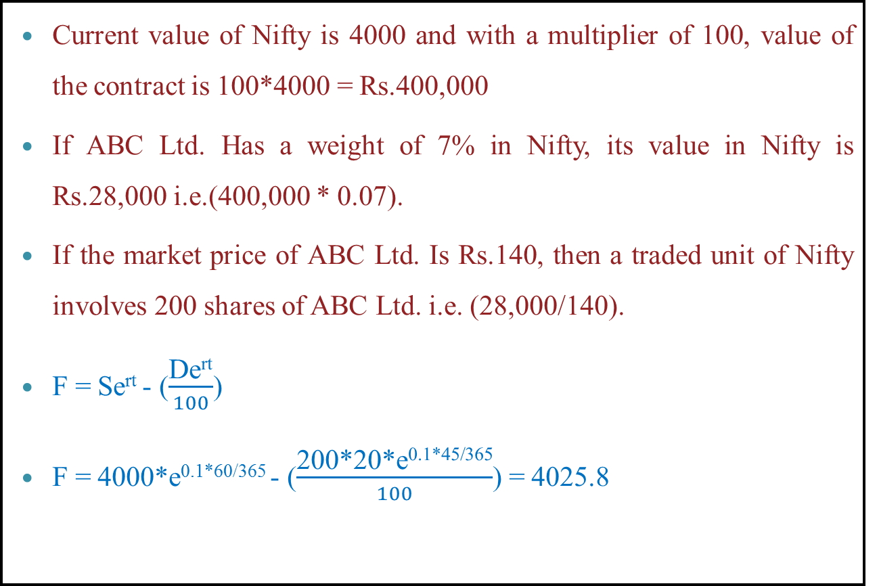
Pricing index futures given expected dividend amount
Current value of Nifty is 4000 and with a multiplier of 100, value of the contract is 100*4000 = Rs.400,000
If ABC Ltd. Has a weight of 7% in Nifty, its value in Nifty is Rs.28,000 i.e.(400,000 * 0.07).
If the market price of ABC Ltd. Is Rs.140, then a traded unit of Nifty involves 200 shares of ABC Ltd. i.e. (28,000/140).
F = Se^{rt} - ($\frac{\text{De}\text{rt}}{100}$)
F = 4000*e^{0.1*60/365} - ($\frac{\text{200∗20∗}\text{e}\text{0.1∗45/365}}{100}$) = 4025.8

Slide 114
If expected dividend given in yield
F = Se(^{r – q})^{t}
F futures price
S spot index value
r cost of financing
q expected dividend yield
T holding period

Slide 115
If expected dividend given in yield
A 2 -month futures contract trades on the NSE. The cost of financing is 10% and the dividend yield on Nifty is 2% annualized. The spot value of Nifty 4000. What is the fair value of the futures contract
F = Se^{(r – q)t}
F = 4000e^{(.1 – .02)} ^{60/365}
Rs.4052.95

Slide 116
PARTICIPANTS IN THE DERIVATIVES MARKETS

Slide 117
PARTICIPANTS
PARTICIPANTS
Hedgers
Speculators
Arbitrageurs

Slide 118
Speculators
These are individuals who take a view on the future direction of the markets.
They take a view whether prices would rise or fall in future and accordingly buy or sell futures and options to try and make a profit from the future price movements of the underlying asset

Slide 119
Arbitrageurs
They take positions in financial markets to earn riskless profits. The arbitrageurs take short and long positions in the same or different contracts at the same time to create a position which can generate a riskless profit

Slide 120
Hedgers
These are investors with a present or anticipated exposure to the underlying asset which is subject to price risks.
Hedgers use the derivatives markets primarily for price risk management of assets and portfolios

Slide 121
Hedging with futures Vs Forward
Hedging with | Benefits | Issues
Futures | Centralized trading and liquidity | Basis Risk
Forward | Fulfill actual need | Default Risk

Slide 122
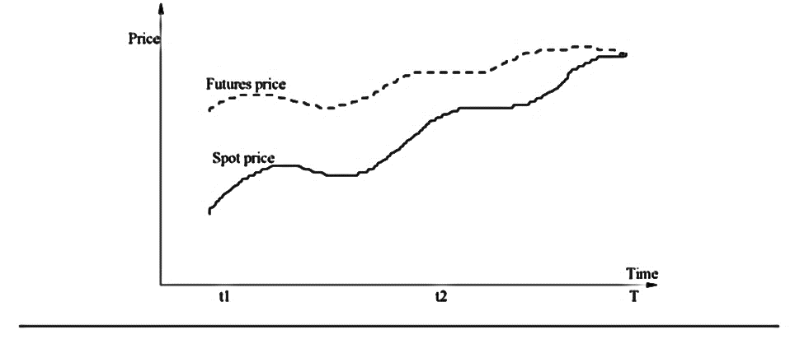
Basis Risk

Slide 123
Basis risk
Basis: The Spot price minus future price
Basis risk: Risk of change in basis
Hedger may be uncertain as to the exact date when asset is bought or sold.
Hedge may require the futures contract to be closed out well before its expiration date.

Slide 124
Long hedge
Mr. X. is a gold Importer.
He is expecting to Pay 1,00,000$ in month of March.
Jan price of spot USDINR is 60 and price in Feb of march Contract USDINR is 65.
So he is worried about change in price.
Now he wants to transfer price risk, means he want to hedge.

Slide 125
Basis-up
UP
Basis-nc
Basis-dw
Price
NC
Basis-nc
Basis-up
DOWN
Basis-nc
Basis-dw

Slide 126
Long Hedge case 1 (No change in basis)
Suppose that
S₁ : Final Asset Price (60)
F₁ : Initial Futures Price (65)
S₂ : Final Asset Price (65)
F₂ : Final Futures Price (70)
You hedge the future purchase of an asset by entering into a long futures contract
Cost of Asset= F₁ - (F₂ - S₂) = F₁ - Basis (b₂) = 65 - (70 – 65) = 60
5
5

Slide 127
Long Hedge case 2 (No change in basis)
Suppose that
S₁ : Final Asset Price (60)
F₁ : Initial Futures Price (65)
S₂ : Final Asset Price (40)
F₂ : Final Futures Price (45)
You hedge the future purchase of an asset by entering into a long futures contract
Cost of Asset= F₁ - (F₂ - S₂) = F₁ - Basis (b₂) = 65 - (45 – 40) = 60
5
5

Slide 128
Long Hedge case 3 (Increase in basis)
Suppose that
S₁ : Final Asset Price (60)
F₁ : Initial Futures Price (65)
S₂ : Final Asset Price (65)
F₂ : Final Futures Price (75)
You hedge the future purchase of an asset by entering into a long futures contract
Cost of Asset= F₁ - (F₂ - S₂) = F₁ - Basis (b₂) = 65 - (75 – 65) = 55
5
10

Slide 129
Long Hedge case 4 (Increase in basis)
Suppose that
S₁ : Final Asset Price (60)
F₁ : Initial Futures Price (65)
S₂ : Final Asset Price (40)
F₂ : Final Futures Price (50)
You hedge the future purchase of an asset by entering into a long futures contract
Cost of Asset= F₁ - (F₂ - S₂) = F₁ - Basis (b₂) = 65 - (50 – 40) = 55
5
10

Slide 130
Long Hedge case 5 (Decrease in basis)
Suppose that
S₁ : Final Asset Price (60)
F₁ : Initial Futures Price (65)
S₂ : Final Asset Price (65)
F₂ : Final Futures Price (67)
You hedge the future purchase of an asset by entering into a long futures contract
Cost of Asset= F₁ - (F₂ - S₂) = F₁ - Basis (b₂) = 65 - (67 – 65) = 63
5
2

Slide 131
Long Hedge case 6 (Decrease in basis)
Suppose that
S₁ : Final Asset Price (60)
F₁ : Initial Futures Price (65)
S₂ : Final Asset Price (40)
F₂ : Final Futures Price (42)
You hedge the future purchase of an asset by entering into a long futures contract
Cost of Asset= F₁ - (F₂ - S₂) = F₁ - Basis (b₂) = 65 - (67 – 65) = 63
5
2

Slide 132
Short hedge
Today is March 1. A US company expects to get 50 million Japanese yen at the end of July.
Contract size= 12.5 million yen
Future price (September ) on March 1= 0.7800 cents/yen
Company enters September Future.
In July when the Yen is received the spot and futures price are 0.7200 and 0.7250 cents/Yen respectively.
Payoff?

Slide 133
Short 4 contracts
In the spot market sell Yen @ 0.7200 cents /yen
Gain from futures contract= 0.7800-0.7250 cents/Yen=0.0550 cents/ Yen
Therefore effective price obtained per yen = 0.7200 + 0.0550 = 0.7750 cents/Yen
______________________
Alternatively.
Basis when the contract is closed out = 0.7250 - 0.7200 = 0.0050
F₁ - b₂= 0.7800-0.0050=0.7750 cents/Yen

Slide 134
Long hedge
Its June 8. A company needs to purchase 20,000 barrels of crude in Oct/Nov. Contract size is 1000 barrels
On June 8, December contract future price is $18.00 per barrel. Company buys 20 contracts (long)
On Nov 10 company decides to purchase the crude oil. The spot and futures price are $20.00 and $19.10 per barrel respectively.
payoff

Slide 135
In the spot market buy crude @ $20.00 per barrel
Gain from futures contract= $19.10-$18.00$ per barrel = $1.10 per barrel
Therefore effective price paid per barrel = $20.00 - $1.10= $ 18.90 per barrel
_____________________________
Alternatively.
Basis when the contract is closed out = $19.10 - $20.00 =
-$0.90
F₁ - b₂= $18 + $0.90 =$ 18.90 per barrel

Slide 136
Contango
On account of the cost of carry, futures price is higher than the spot price of the same underlying i.e. basis is positive. Such a relative price position is called contango

Slide 137
Backwardation
Some times, extremely bearish market situations or any technical factors, the futures price may be trading lower than the spot price of the same underlying. In such situations, the stock is said to be in backwardation

Slide 138
Hedging
Long security, sell futures

Slide 139
Hedging: Long security, sell futures
Lets take an example:
An investor who holds the shares of a company and gets uncomfortable with market movements in the short run.
He expects that security falling from Rs.450 to Rs.390.
In the absence of stock futures, he would either suffer the discomfort of a price fall or sell the security in anticipation of a market upheaval
With security futures he can minimize his price risk.

Slide 140
Hedging: Long security, sell futures
Take offsetting stock futures position. Means a short futures position.
Assume that spot price is 450 and two month futures is 490.
Current position of investor is long security @ 450 and sell futures @ 490.
Lets take a case price of his security falls to Rs.390, The fall in the price of the security will result in a fall in the price of futures
Futures price will be 430 (Approx)
Loss in spot hedge by futures
Warning: it also stop our profit

Slide 141
Speculation
Bullish security, buy futures

Slide 142
A speculator who has a view on the direction of the market.
He would like to trade based on this view.
He believes that a particular security that trades at Rs.1000 is undervalued and expect its price to go up in the next two-three months.
In the absence of a derivatives product, he would have to buy the security and hold on to it.
Lets see how its works

Slide 143
Without derivative
Assume he buys a 100 shares which cost him one lakh rupees.
His hunch proves correct and two months later the security closes at Rs.1010.
He makes a profit of Rs.1000 on an investment of Rs. 1,00,000 for a period of two months.
This works out to an annual return of 6 percent.

Slide 144
With derivative
Today a speculator can take exactly the same position on the security by using futures contracts.
Let us see how this works. The security trades at Rs.1000 and the two-month futures trades at 1006.
He buys 100 security futures @ 1006 for which he pays a margin of Rs.20,000.
Two months later the security closes at 1010.
On the day of expiration, the futures price converges to the spot price and he makes a profit of Rs.400 on an investment of Rs.20,000.
This works out to an annual return of 12 percent

Slide 145
Speculation
Bearish security, sell futures

Slide 146
Without derivative
Stock futures can be used by a speculator who believes that a particular security is over-valued and is likely to see a fall in price.
How can he trade based on his opinion?
In the absence of a derivatives product, he can earn profit only if he has shares, if yes he can sell shares now and but after 2 month at a cheaper price

Slide 147
With derivative
He sells one two-month contract of futures on ABC at Rs.240 (each contact for 100 underlying shares). He pays a small margin on the same.
Two months later, when the futures contract expires, ABC closes at 220.
He has made a clean profit of Rs.20 per share.
For the one contract that he bought, this works out to be Rs.2000.

Slide 148
Arbitrage
Overpriced futures: buy spot, sell futures

Slide 149
If you notice that futures on a security that you have been observing seem overpriced, how can you cash in on this opportunity to earn riskless profits
ABC Ltd. trades at Rs.1000. One-month ABC futures trade at Rs.1025 and seem overpriced.
As an arbitrageur, you can make riskless profit by entering into the following set of transactions.

Slide 150
On day 1, borrow funds, buy the security on the spot market at 1000.
Simultaneously, sell the futures on the security at 1025.
Hold the security for a month.
On the futures expiration date give delivery at Rs.1025.
Return the borrowed funds @ 1000
Profit of Rs.25.

Slide 151
Arbitrage
Underpriced futures: buy futures, sell spot

Slide 152
If you notice that futures on a security that you have been observing seem underpriced, how can you cash in on this opportunity to earn riskless profits
ABC Ltd. trades at Rs.1000. One-month ABC futures trade at Rs.965 and seem underpriced.
As an arbitrageur, you can make riskless profit by entering into the following set of transactions.
Arbitrager can earn profit only if he has shares/commodity

Slide 153
On day 1, sell the security on the spot market at 1000.
Simultaneously, buy the futures on the security at 965.
Invest 1000 rupee in debt market and earn 10 rupee interest (assumed)
Hold the security for a month.
On the futures expiration date take delivery at Rs.965. and make a payment of 965
Profit of Rs.45.

Slide 154


That’s all for the DAY!!!

